Slide 1
BCSE309L – Cryptography and Network Security

Slide 2
Factor

Slide 3
Factor
A factor is a number that divides another number evenly with no remainder
Factors are numbers you multiply to get other numbers
Factors of 24: ?

Slide 4
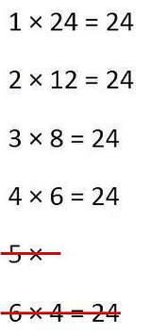
Factor
A factor is a number that divides another number evenly with no remainder
Factors are numbers you multiply to get other numbers
Factors of 24: 1,2,3,4,6,8,12,24
Factors of 48 : ?
Factors of 32: ?

Slide 5
Factor
A factor is a number that divides another number evenly with no remainder
Factors are numbers you multiply to get other numbers
Factors of 24: 1,2,3,4,6,8,12,24
Factors of 48: 1,2,3,4,6,8,12,16, 24, 48
Factors of 32: ?

Slide 6
Factor
A factor is a number that divides another number evenly with no remainder
Factors are numbers you multiply to get other numbers
Factors of 24: 1,2,3,4,6,8,12,24
Factors of 48: 1,2,3,4,6,8,12,16, 24, 48
Factors of 32: 1, 2, 4, 8, 16, 32

Slide 7
GCD

Slide 8
Greatest Common Divisor
GCD of two or more integers which are not zero is the greatest positive integer that divides each of the integers.
GCD of two numbers is the greatest number that divides both the numbers.
Ex: GCD of 12 and 8 is 4

Slide 9
GCD using Factorization

Slide 10
GCD(12,33)=?

Slide 11
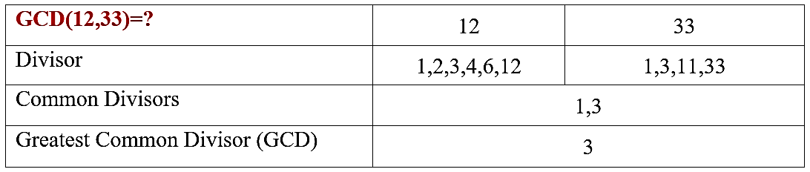
GCD using Factorization
EX:1
GCD(12,33)=3

Slide 12
GCD(25,150)=?

Slide 13
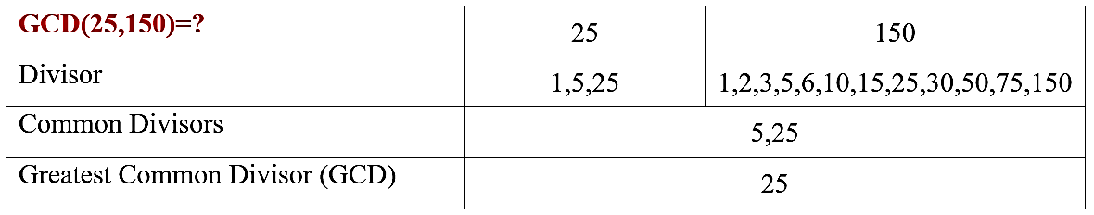
GCD using Factorization
EX:2
GCD(25,150)=25

Slide 14
GCD(13,33)=?

Slide 15
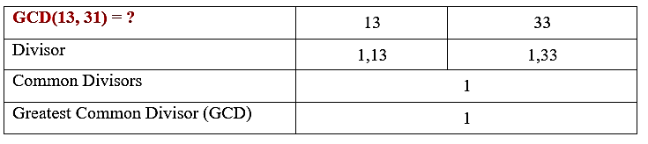
GCD using Factorization
EX:3 - Prime numbers
GCD(13,33)=?

Slide 16
GCD by Division Method

Slide 17
GCD by Division Method
First take two of the given numbers
Divide the greater by the smaller number
Then divide the divisor by the remainder
The divisor which does not leave a remainder is the gcd of the two numbers.

Slide 18
GCD(1785,546)=?

Slide 19
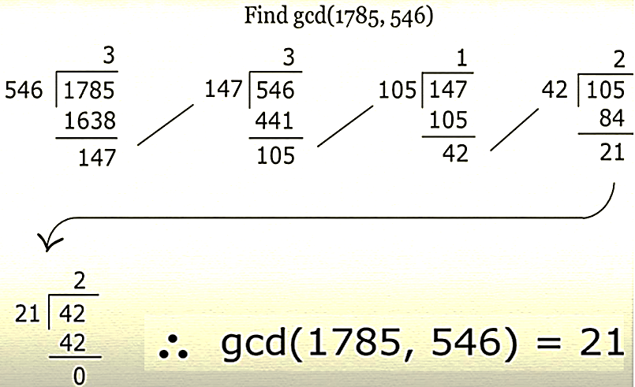
EXAMPLE

Slide 20
GCD(48,60)=?

Slide 21
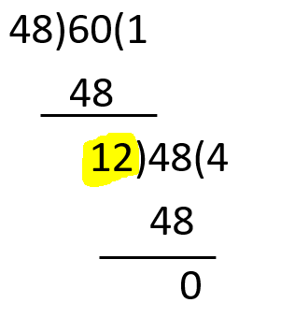
EXAMPLE
GCD(48,60)=?
48)60(1
48
12)48(4
48
0
GCD (48,60)=12

Slide 22
GCD(48,60,38)=?

Slide 23
GCD(48,60,38)=?
gcd(a,b,c)=gcd(gcd(a,b),c)

Slide 24
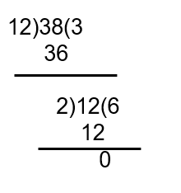
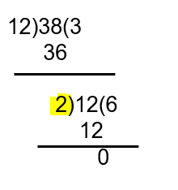
EXAMPLE
GCD(48,60,38)=?
48)60(1
48
12)48(4
48
0
GCD (48,60,38)=2

Slide 25
GCD(48,60,54,12)=?

Slide 26
GCD(48,60,54,12)=?
Gcd(a,b,c,d)=gcd(gcd(a,b),gcd(c,d))

Slide 27
GCD(48,60,54,12)=6

Slide 28
GCD by Division Method - Exercise
Find the GCD of 30 and 45
Find the GCD of 442 and 546
Find the GCD of 442,546,424
Find the GCD of 3036,252
Find the GCD of 3036,252,1026

Slide 29
GCD by Division Method - Exercise
Find the GCD of 30 and 45 → 15
Find the GCD of 442 and 546
Find the GCD of 442,546,424
Find the GCD of 3036,252
Find the GCD of 3036,252,1026

Slide 30
GCD by Division Method - Exercise
Find the GCD of 30 and 45 → 15
Find the GCD of 442 and 546 →26
Find the GCD of 442,546,424
Find the GCD of 3036,252
Find the GCD of 3036,252,1026

Slide 31
GCD by Division Method - Exercise
Find the GCD of 30 and 45 → 15
Find the GCD of 442 and 546 →26
Find the GCD of 442,546,424 → 2
Find the GCD of 3036,252
Find the GCD of 3036,252,1026

Slide 32
GCD by Division Method - Exercise
Find the GCD of 30 and 45 → 15
Find the GCD of 442 and 546 →26
Find the GCD of 442,546,424 → 2
Find the GCD of 3036,252 → 12
Find the GCD of 3036,252,1026

Slide 33
GCD by Division Method - Exercise
Find the GCD of 30 and 45 → 15
Find the GCD of 442 and 546 →26
Find the GCD of 442,546,424 → 2
Find the GCD of 3036,252 → 12
Find the GCD of 3036,252,1026 → 6

Slide 34
Modular Arithmetic
Modular Exponentiation
a^{p} mod n

Slide 35
11⁷ mod 13 = ?

Slide 36
11⁷ mod 13 = ?
11⁷ = 11⁴ * 11² *11
11⁷mod 13= (11⁴ mod 13 * 11² mod 13 *11 mod 13) mod 13

Slide 37
Modular Arithmetic
Modular Exponentiation
11⁷ mod 13 = ?
11⁷ = 11² * 11⁴ *11
11² = 121 mod 13
= 9*13 +4 mod 13
= 4 mod 13
= 4
11⁷ = 11⁴ * 11² *11

Slide 38
Modular Arithmetic
Modular Exponentiation
11⁴ = (11²)²mod 13
= 4² mod 13
= 16 mod 13
= 3
11⁷ mod 13 = ?
11⁷ = 11² * 11⁴ *11
11² = 121 mod 13
= 9*13 +4 mod 13
= 4 mod 13
= 4
11⁷ = 11⁴ * 11² *11

Slide 39
Modular Arithmetic
Modular Exponentiation
11⁴ = (11²)²mod 13
= 4² mod 13
= 16 mod 13
= 3
11⁷ mod 13 = ?
11⁷ = 11² * 11⁴ *11
11² = 121 mod 13
= 9*13 +4 mod 13
= 4 mod 13
= 4
11⁷ = 11⁴ * 11² *11
Now apply all
11⁷ = 11⁴ * 11² *11 mod 13
=3 * 4 *11 mod 13
= 132 mod 13
= 130 mod 13 +2 mod 13
= 0 + 2 mod 13
= 2 mod 13
= 2

Slide 40
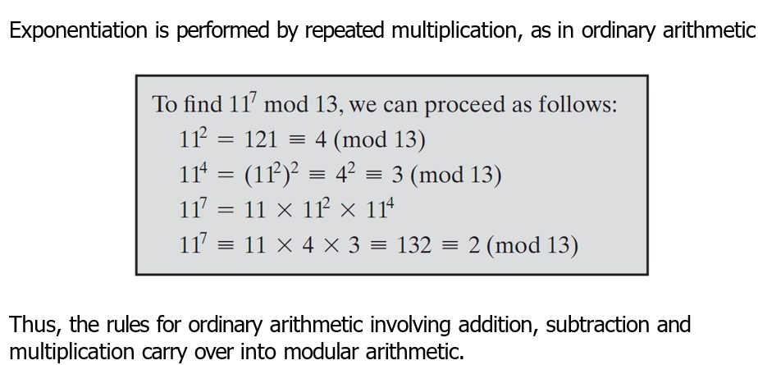
Modular Arithmetic
Modular Exponentiation
11⁷ mod 13 = ?
11⁷ = 11² * 11⁴ *11
11² = 121 mod 13
= 9*13 +4 mod 13
= 4 mod 13
= 4
11⁴ = (11²)²mod 13
= 4² mod 13
= 16 mod 13
= 3
Now apply all
11⁷ = 11² * 11⁴ *11 mod 13
=4 * 3 *11 mod 13
= 132 mod 13
= 130+2 mod 13
= 2 mod 13
= 2

Slide 41
Fast Modular Exponentiation

Slide 42
Fast Modular Exponentiation
a^{b} mod c = ?
Ex: 3²⁹ mod 7 = ?
2⁴ 2³ 2² 2¹ 2⁰
16 8 4 2 1
1 1 1 0 1 → 16+8+4+1 = 29
29 = (2⁰ +2²+2³+2⁴ )
3²⁹ mod 7 = 3¹⁶⁺⁸⁺⁴⁺¹mod 7
= (3¹⁶ mod 7 * 3⁸ mod 7 * 3⁴ mod 7 * 3¹ mod 7) mod 7

Slide 43
3²⁹ mod 7 = 3¹⁶⁺⁸⁺⁴⁺¹mod 7
= (3¹⁶ mod 7 * 3⁸ mod 7 * 3⁴ mod 7 * 3¹ mod 7) mod 7
3¹ mod 7 = 3
3⁴ mod 7 = 3² mod 7 * 3² mod 7
= 9 mod 7 * 9 mod 7
= 2 * 2 mod 7
= 4 mod 7
= 4
3⁸ mod 7 = 3⁴⁺⁴ mod 7
= 3⁴ mod 7 * 3⁴ mod 7
= 4 * 4 mod 7
= 16 mod 7
= 2
Or
(3˄4)˄2 mod 7 = 4˄2 mod 7
3¹⁶ mod 7 = 3¹⁶ mod 7
= (3⁸)² mod 7
= 2² mod 7
= 4 mod 7
= 4
3²⁹ mod 7 = 3¹⁶ mod 7 * 3⁸ mod 7 * 3⁴ mod 7 * 3¹ mod 7
= 4 * 2 *4 * 3 mod 7
= 96 mod 7
= 5
3²⁹ mod 7 = 5

